Slide 1
HOPE End of Study:
Plans and Timeline

Slide 2
Overview
HOPE End of Study Plans and Timeline
  HOPE Study Duration
  Planning for Study Exit
  When will Results be Available?
What the HOPE Study Contributes
What’s Next for the Dapivirine Ring?

Slide 3
HOPE Study Duration
The HOPE study was designed so that all women who enroll participate for the same amount of time - about one year.
At the Month 12 visit, participants will have their product use end visit (PUEV) and dapivirine ring use will stop
Screen
Enroll
M1
M2
M3
M6
M9
M12: PUEV
M13:Exit
Participants will have one additional month of follow-up (without the ring), and then exit from HOPE at Month 13

Slide 4
Why do some women have to exit the HOPE study now when others are still continuing study visits?

Slide 5
Staggered Exit
All HOPE participants receive an equal amount of time in the study, but will exit at different times depending on when they enrolled.
The women who are continuing with study visits now have not yet reached their one year of follow-up time.
When they reach this milestone, they will be exited as well.
Sep 16
Oct 16
Nov 16
Dec 16
→
Aug 17
Sep 17
Oct 17
Nov 17
Dec 17
Aug 16
Enrollment
Study Exit
Notes:
**Note that some women who enrolled very late may participate in HOPE for less than one year. These women were informed of this shortened follow-up time prior to agreeing to enroll in the study.

Slide 6

When will PUEVs start?
Across all sites, the first HOPE PUEV is targeted for July 2017, followed by the first Study Exit in August 2017
At this site, the first PUEVs will start in [sites to insert relevant dates and modify image below]
July 2017
Aug 2017
1st PUEV 1st Exit Visit

Slide 7
Why was HOPE designed to be only one year of follow-up?

Slide 8

One Year of Follow-up Time
Following each participant for one year provides enough data to answer the study’s questions within a timeframe that could help inform ongoing regulatory submissions for the ring.
HOPE is similar to other HIV prevention open label extension studies that have been conducted to date, which lasted between 1-2 years.
Notes:
TDF2 – 1 year; Partners PrEP Study Extension- 1 year; iPrEx – 18 months; CAPRISA 008 – 2 years

Slide 9
Preparing to Exit the Study
You may have some questions as you get closer to study exit, such as:
  Once I am no longer in the study, how will I be protected from HIV?
  Where will I get contraception?
  Where will I get health care?
  Are there other HIV prevention research studies that I can join?
  When will HOPE results be available?
We will go through these topics now and encourage you to ask any other questions you have

Slide 10
Once I am no longer in the study, how will I be protected from HIV?

Slide 11

HIV Prevention Options After HOPE
We acknowledge that many participants may live at high risk of acquiring HIV, and options for protection are limited.
Before exiting the study, participants will receive counseling on different HIV prevention options, including how to access certain services after they leave the study.
That is exactly why we are doing this work—to potentially expand the prevention options available to women in our communities.

Slide 12
HIV Prevention Options after HOPE may include:
Use condoms consistently and correctly
Encourage partner to get tested for HIV and STIs
Encourage partner to get circumcised to lower their risk
Use oral PrEP, if available
If your partner is HIV+, encourage ARV adherence
Reduce number of sex partners
Get frequent HIV and STI testing, and treatment for STIs as needed
Engage in lower-risk sexual behaviours

Slide 13
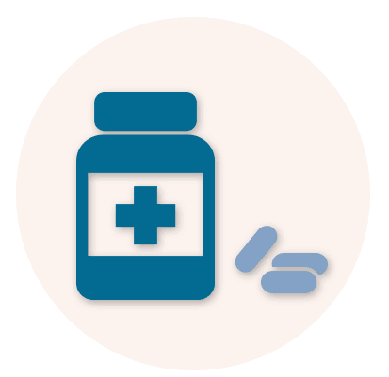
Oral PrEP
Oral PrEP for HIV prevention is a strategy that involves daily use of antiretroviral medication, Truvada, by people who are HIV negative.
PrEP is increasingly becoming available and many countries are actively developing national policies and plans for access.
PrEP is very effective in reducing the risk of acquiring HIV infection when used consistently.
Notes:
Note to Sites: Feel free to move slides about Oral PrEP to the additional Q&A section, if not available currently in country.

Slide 14
Oral PrEP
[Sites to add site-specific slides about availability of Oral PrEP, based on SOPs, as appropriate]

Slide 15

HIV Prevention Options After HOPE
Although all options may not be possible for all people, the more of these things a person can do, the lower their chance of getting HIV.

Slide 16
Where will I get contraception after I exit the study?

Slide 17
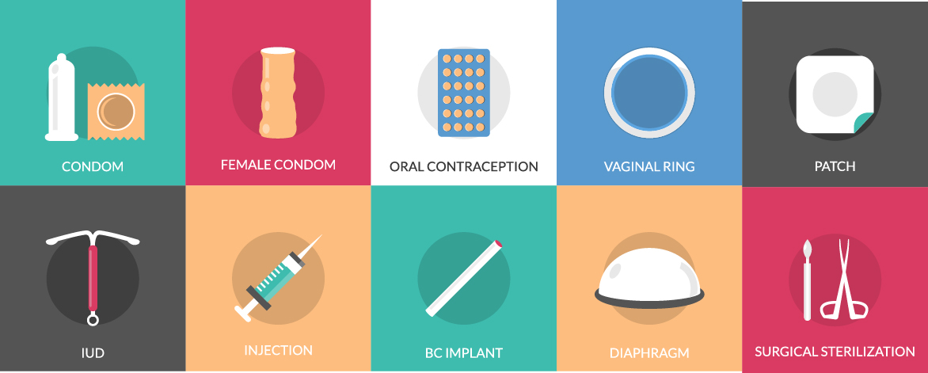
Accessing Contraception After HOPE
Before you exit from HOPE, study staff will have a conversation with you about what contraceptive method you prefer, and how you can access this method after you exit the study.
If you want to change or stop your family planning method before you exit from the study, staff will help you make this change.
Notes:
If you prefer to use a short-term method like the pill or injections, the site will make sure to refer you to a clinic or organization where you can keep accessing the method of your choice
If you are using a longer-term method, like the IUCD or implants:
And wish to continue using this method, the site staff can give you a list of organizations where you can have this contraceptive device removed or replaced when that time arrives.
And you want to change or stop before exiting the study, the study team will work with you to make this switch before you exit HOPE

Slide 18
Where will I get health care after I exit the study?

Slide 19

Accessing Health Care After HOPE
If you have any ongoing issues at study exit, we will refer you to a local facility for continued care.
If you need medical care after study exit, or if you would like HIV or STI testing or treatment, you can contact the research site for information on where to access care.
The study team wants to make sure you continue to get the care you need to stay healthy!

Slide 20
Local Facilities
[Optional Slide for sites to insert with local care facility information]

Slide 21
Are there other HIV prevention research studies that I can join?

Slide 22

Joining Other Research Studies
[For sites with other ongoing studies:]
There may be other HIV prevention research ongoing at this site or at research centers nearby.
If you are interested, we can provide you with information about this research.
Many studies require that you take a break between studies. If this time has passed, and you meet other eligibility criteria, you may be able to enroll.

Slide 23
Joining Other Research Studies
[For sites without other ongoing research]:
At this time, there are no other HIV prevention studies ongoing at this site or at research centers nearby.
If you are interested in participating in potential future studies, please be sure to let staff know and keep your contact information up to date.
Should there be a study that you may be eligible for in the future, we will reach out to you and provide you with information about this research.

Slide 24
What are demonstration projects and can I participate in them or in future ring studies?

Slide 25
Demonstration Projects
Demonstration projects look at how new interventions are working in more real-world settings and may be planned if the ring is approved in the future.
Each new study or demonstration project will have its own rules about who can participate. If you want to know about future studies, be sure to let us know and keep your contact information updated.

Slide 26
When will HOPE results be available?

Slide 27

HOPE Results
All HOPE study visits will be completed by the end of September 2018.
Results from HOPE should be available about 6 months later, in the first half of 2019.
As soon as results are available, we will reach out to HOPE participants to share information. Please be sure that your contact information is up to date with study staff.

Slide 28

What the HOPE Study Contributes & Next Steps for the Dapivirine Ring

Slide 29
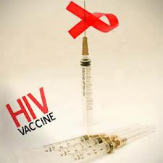
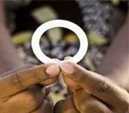

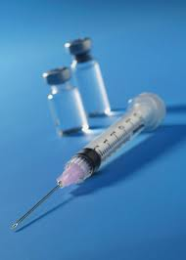
Women Need Options for HIV Prevention
Women in Africa, especially young women, have been among the most impacted by HIV.
They desperately need options in HIV prevention that are safe, effective, and acceptable.
ASPIRE and The Ring Study have helped advance women’s options for HIV prevention, and could lead to approval of the dapivirine ring.
Vaccine
Vaginal ring
Oral PrEP
Injectable

Slide 30

What HOPE Contributes
In HOPE, we are learning more about:
Safety of the ring
How women use the ring knowing that it can help reduce their risk of acquiring HIV
How good the ring is at preventing HIV, especially when used with higher adherence
Reasons women decline HOPE participation or use of the ring
Real-life considerations for ring use
Notes:
As a placebo-controlled, investigational trial, ASPIRE could not answer whether women would have used the ring better if they had known it was effective and safe—this is what HOPE offers us.

Slide 31
What can you tell us about the DREAM study?

Slide 32

The DREAM Study
DREAM is the sister study of HOPE with former participants from The Ring Study in Uganda and South Africa.
DREAM was designed to provide participants with access to the ring for one year, with an option to continue for longer.

Slide 33
Are you planning other studies of the ring?

Slide 34


Additional Research with the Ring
Studies to better understand HIV prevention needs of younger women and adolescent girls are starting soon.
Safety studies of ring use during pregnancy and breastfeeding are also being planned.
Other studies looking at a 3-month ring and a ring that includes both a contraceptive and dapivirine are underway.

Slide 35

MTN-032 (AHA) Phase 2
[for 032 sites only, other sites to delete]
At this site, we are also conducting a qualitative study about HOPE participants’ experience with the ring after they exit the HOPE study. If you are interested, you can give us permission to contact you later and you may be invited to complete a single interview or focus group discussion.
Notes:
These slides are only relevant for sites also implementing MTN-032

Slide 36
MTN-032 (AHA) Male Partners
[for 032 sites only, other sites to delete]
As part of the AHA study, we will also be conducting interviews and focus group discussions with male sexual partners of former HOPE participants to learn more about their thoughts on the ring.
Male participants in AHA will know that their partners participated in HOPE, whether their partners were acceptors of the vaginal ring, and that the ring is an HIV-prevention method.
Notes:
These slides are only relevant for sites also implementing MTN-032

Slide 37

MTN-032 (AHA) Male Partners Cont.
[for 032 sites only, other sites to delete]
If you are interested, let us know if we can contact your partner. Allowing us to contact your partner is your choice, and does not impact your ability to participate in other studies or access care at this site.
Notes:
These slides are only relevant for sites also implementing MTN-032

Slide 38
How and when may the ring be approved for public use?

Slide 39

Regulatory Approvals
IPM, the developer of the ring, is in the process of submitting applications to different regulatory authorities to approve the ring for use. These submissions are occurring while HOPE and DREAM are still taking place!
These submissions and the review process take time. The earliest that some African countries would make a decision is 2019.
If approved, the dapivirine ring would be the first biomedical HIV prevention product exclusively for women – and the first long-acting product.

Slide 40
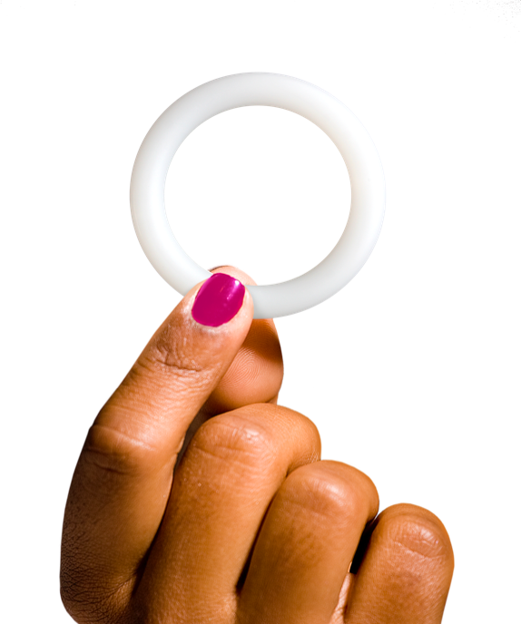
Regulatory Path: Overview
European Medicines Agency (EMA)
World Health Organization (WHO)
South African Medicines Control Council (MCC)
US Food and Drug Administration (FDA)
African National Regulatory Authorities
  Scientific opinion via Article 58
    Submitted June 2017; currently under review
Why WHO Prequalification (PQ)?
Process to evaluate whether a drug meets global standards
• Quality
• Safety
• Efficacy
Most African regulatory agencies use WHO prequalification to determine which new products to approve, and review EMA scientific opinion
  Following WHO PQ, first submissions to Kenya, Malawi, Rwanda, Tanzania, Uganda, Zambia, Zimbabwe
  Target submission Q1 2018
  Target submission 2018
Notes:
IPM is regulatory sponsor
First application (EMA) submitted June 2017
Hopeful first approvals in some African countries as soon as early 2019

Slide 41




Regulatory Timeline
2016
2017
2018
2019
2020
Results
Open-label extension study: DREAM
Open-label extension study: HOPE
African adolescents safety study: REACH
Supporting safety and PK studies
Safety studies in pregnant and breastfeeding women
EMA Article 58
WHO PQ
African NRAs (submission & approval)
FDA
S. Afr. MCC (SAHPRA)
Notes:
Slide last updated: 27 Sept 2017
IPM provides updates on dapivirine ring progress to all the agencies in countries where we are hoping the ring will ultimately be made available

Slide 42
Do you think the ring will be approved?

Slide 43
Will the Ring be approved?
We are hopeful the ring will be approved.
We should all feel proud of the contributions we have made to bring us to this point.
It is now up to the regulatory authorities to decide to approve the ring or not. Study staff can give you more information about who these regulatory authorities are, if you want.

Slide 44
When could the ring be available to women? Would it be available to HOPE participants before the general public?

Slide 45
Timeline for Potential Availability
Even with regulatory approval, the ring would not be available right away.
Each country’s government would still be responsible for deciding if, how, and when the ring would be available.
The ring would be made available to former HOPE participants at the same time as other women.

Slide 46
Why does it take so long?

Slide 47

Why does it take so long?
Dapivirine is a new drug that has never been used outside of a clinical trial before.
IPM has compiled information from 250 studies spanning almost 15 years into an application that totals 260,000 pages!
Regulators must review this information carefully in deciding whether or not to approve the dapivirine ring.
Remember – HOPE is happening at the same time as regulatory approvals, so it does not delay the process!

Slide 48
Why can’t women have access to the ring until it’s approved and available?

Slide 49


Access to the Ring
We can only provide the ring to women while they are enrolled in the HOPE study and follow-up was designed to last for one year.
After exiting HOPE, participants would have access to the ring if and when it is approved and made publicly available.

Slide 50
What is the anticipated cost of the ring and where would I get it?

Slide 51

Anticipated Cost
The cost is expected to be about 7 USD per ring or about 84 USD a year for 12 rings [site to insert local conversion]
Governments and donors would pay these costs –this means the ring would be available to women at very low cost or for free
Specific pricing plans may vary by country

Slide 52
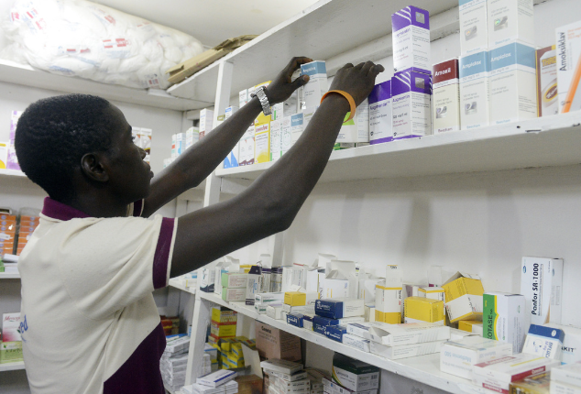
Anticipated Access
Since the ring contains an ARV drug, some countries may require a health worker to prescribe or dispense it.
The ring could be distributed at health clinics, hospitals, and/or private pharmacies.

Slide 53

Looking Ahead…
We are extremely grateful for the investment of time and energy you have given to both ASPIRE and HOPE!
We hope you feel proud of the contribution you have made to improving the options women have to prevent HIV.
Although the process is complicated and takes time, we hope the ring will be approved and we can all celebrate together!

Slide 54
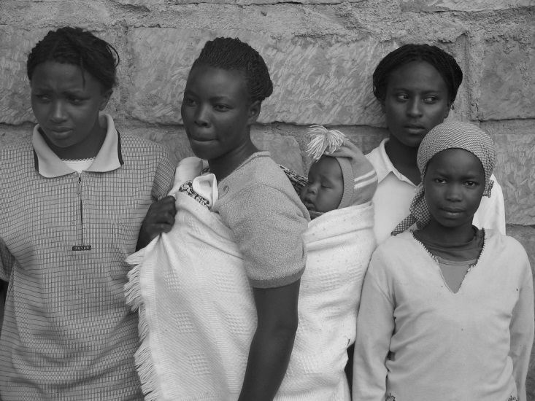
Recognizing Contributions of Participants from ASPIRE and HOPE
It is also something to be proud of when you will tell your relatives even after 50 years that, “Ah do you know that this ring being used, it is us who made it to be approved for use to prevent HIV.” - ASPIRE participant

Slide 55



Thank you!

